Slide 1

CAT T3 Design
Arun Rajayogan

Slide 2
User Input
Get all 4 vertices
Check if they are invalid (duplicates or simply not making any sense i.e a letter in the coordinate), if invalid keep on asking for correct input until valid
Convert all the vertices to tuples, then add the tuples to a list

Slide 3
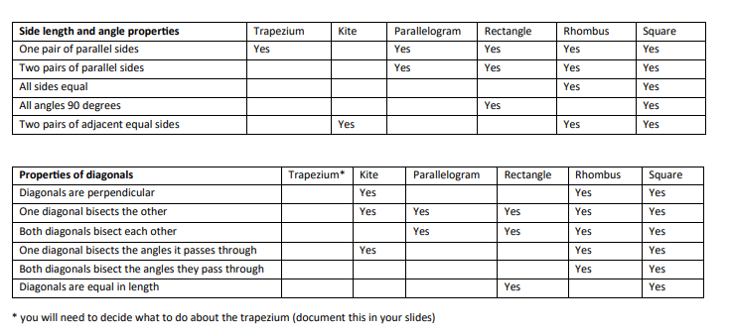
Properties

Slide 4
Properties
Each shape (square, rhombus, rectangle etc.) will have its own set of properties, its own data.
Two sets of data, one for sides and one for the angles.
If the properties of the inputted shape match up, then the match is outputted.
This allows more shapes to be added to the “database(s)” making it very versatile for future use.
A separate function will exist for each property in order to perform multiple simple checks, this makes it more plug and play and so more modular.

Slide 5


Important
Most properties in the table are built from previous properties.
Only a small amount of actual math would be done.
Helps make everything very modular by approaching it this way.

Slide 6
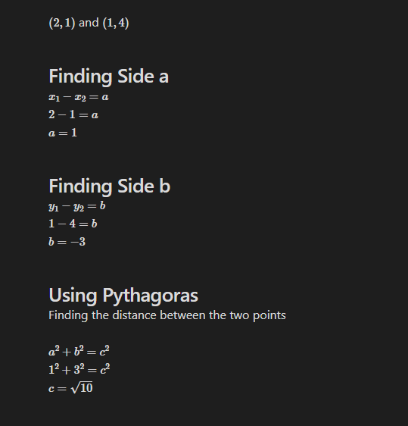
Side Lengths

Slide 7
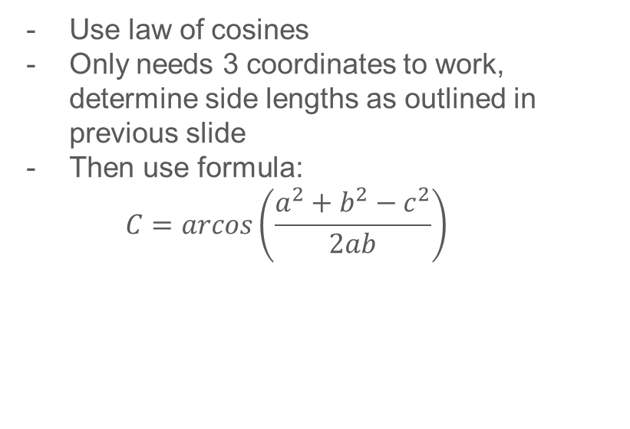
Side Lengths
Use law of cosines
Only needs 3 coordinates to work, determine side lengths as outlined in previous slide
Then use formula:
$$C=arcos\left(\frac{a^{2}+b^{2}−c^{2}}{2ab}\right)$$

Slide 8
Vertices Sort
1
Use first point entered
2
3

Slide 9
Vertices Sort
1
2
Finds greatest angle between all other points
3

Slide 10
1
Vertices Sort
2
3
4th not included point after finding the angle is furthest vertices from starting point.

Slide 11
Sorting Points (In Depth)
Get the first point given in the input. This is will point A for simplicity.
From point A cast a ray to all other point.
Now 3 lines are formed, find 3 angles
As these can only be convex shapes, not concave, the angle which is greatest forms one corner of our shape.
The non-included point is opposite to point A, and is labelled point C
The other two points are B and D, not important which is which.
Appended into a list in the correct order

Slide 12

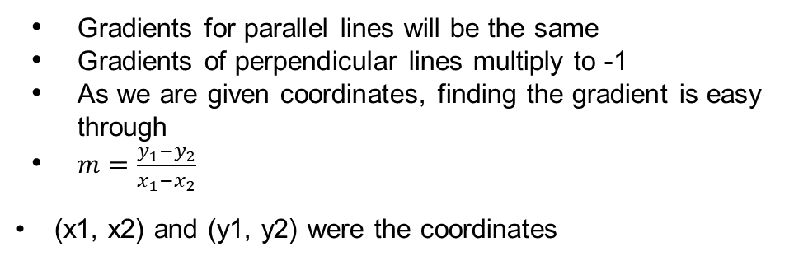
Parallel and Perpendicular Lines
Gradients for parallel lines will be the same
Gradients of perpendicular lines multiply to -1
As we are given coordinates, finding the gradient is easy through
$m=\frac{y_{1}−y_{2}}{x_{1}−x_{2}}$
(x1, x2) and (y1, y2) were the coordinates

Slide 13
THE TRAPEZIUM!

Slide 14
THE TRAPEZIUM!
The definition of a trapezium is that it has one pair of parallel sides, a general trapezium has nothing to do with its diagonals.
So, it won’t be represented in terms of its secondary properties, unless of course we start to include trapezium sub-types, such as the isosceles trapezium.

